Slide 1
Simulation and Modeling
CSE4131_CSE4132

Slide 2
Modeling
Formal definition of Model?
We define a model as the body of information about a system(?) → gathered for the purpose of studying the System.
A model is a simplification of reality.
Formal Definition of System?
Def^{n} of System: A group of interacting, interrelated, or interdependent elements forming a complex whole

Slide 3
Why Modeling continue…..?
To study a system …
sometime … possible to experiment with system
Most time impossible to experiment with system itself.
You can’t modify supply and demand … to study economy system
So we have to build a model

Slide 4
Why Modeling?
Models help us to visualize a system as it is or as we want it to be.
Models permit us to specify the structure or behavior of a system.
Models give us a template that guides us in constructing a system.
Models document the decisions we have made.
We build models so that we can better understand the system we are developing.

Slide 5
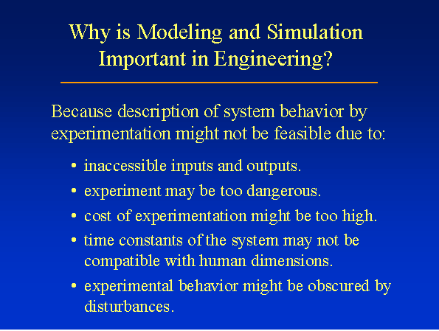

Slide 6
Points to remember
Since the purpose of the study will determine the nature of information that is gathered
there is no unique model of a system
Different models of same system … produced by different analysts different aspect of the system and
Or by same analyst → as understanding the system changes

Slide 7
Deriving a Model
Task of deriving a model ➔ two subtasks
Establishing the model structure
Supplying the data
Establishing the model structure:
Determines the system boundary +
Identifies the entities, attributes and activities of the system
The data provides the values the attributes can have and define the relationships involved in the activities.
N.B.:… they are defined as parts of one task rather than two different task

Slide 8
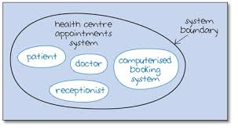
Entities, Attributes and Activities
System Boundary : the line that separate the system with its environment
Entity: Objects of interest within a system: : Machines in factory
Attribute: Denote a property of an entity:speed, capacity
Activity: Any process that cause change within a system is called activity

Slide 9
Some example
System | Entities | Attributes | Activities
Traffic | Cars | Speed Distance | Driving
Bank | Customers | Checking Account Balance | Depositing
Communications | Message | Length Priority | Transmitting
Supermarket | Customer | Shopping List | Checking-out

Slide 10
Types of Model
Basically … model … two category
Physical
Mathematical
Physical → Static or dynamic
Mathematical → Static or dynamic

Slide 11
Physical Model
• Models, properties of which are described by physical structures and relations. Usually applied to high fidelity (detailed) system simulations such as simulators. Example Architectural model of a house(Building) is physical model, vehicle etc.
Reflects the physical laws that drive the model.

Slide 12
Mathematical model
Mathematical model:
… some symbolic notation and mathematical equations to represent the system
System attributes are represented by variables
and activities are represented by mathematical functions

Slide 13
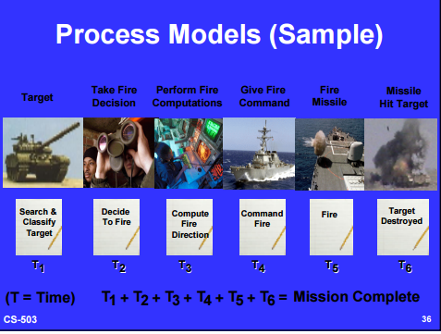
Process Models
• Models the process a system performs.
Represents dynamic relations by mathematical and logical functions.

Slide 14
Another way to classify
Second distinguish ….
Static and dynamic models
Static models can only show the values that system attributes take when the system is in balance.
Values at some particular time
Dynamic models follow the changes over time that result from the system activities

Slide 15
Mathematical Model
In case of mathematical models… Solved Model
a third distinction is the technique by which the model is solved
That is actual values are assigned to the system attributes
A distinction can be made:
Analytical and
Numerical methods
Analytical methods is one which used the deductive reasoning(ন্যায়িক যুক্তি) of mathematical theory to solve a model.
A Linear Programming model, a Mixed Integer Linear Programming model, a nonlinear optimization model are examples of analytical models.
Numerical methods is the one which applying computational procedure to solve equations.
Finding the roots of a nonlinear algebraic equation, f(x) = 0, using the numerical model.

Slide 16
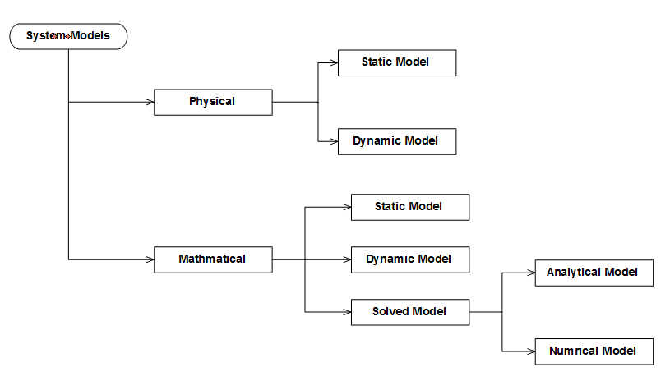
Summary of Classification

Slide 17
Principles used in modeling
Its not possible to provide rules by which mathematical models are built.
But a number of principles can be stated
Principles:
Block building… should be organized in series of blocks.
Relevance … relevant to the study objective.
Accuracy … of information gathered form the system should be considered
Aggregation (মোট পরিমাণ) … in the extent to which the number of individual entities can be grouped together into a large entity

Slide 18
Subsystems
Simple definition of a system:
A set of interacting objects
But description of a system can be made many levels of details.
A system → consisting of interacting subsystem
A subsystem → consisting of subsystems… lower level of details
A system study must begin by deciding on the level of subsystem details to be used.
Group of interconnected and interactive objects that performs an important job or task as a component of a larger system.
Remember the principle…. Block-building principle
Sub system → sub models or blocks

Slide 19
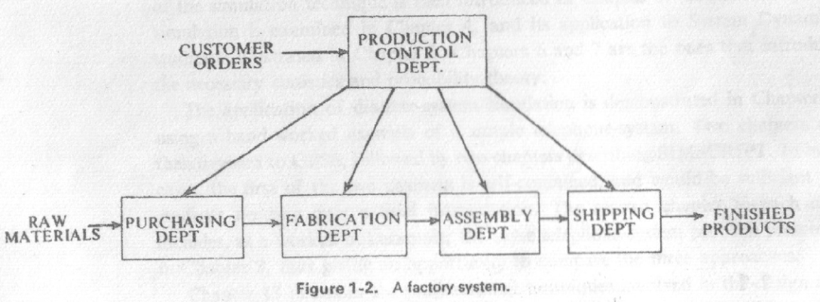
Block building
The description of System → Series of blocks
Few/ Preferably one input → block
Results in few output variables
System → interconnections between blocks.

Slide 20
Relevance
The model should only include → relevant to study objective
For example:
If factory system study aim is to compare the effects of different operating rules on efficiency
Then its not relevance to consider … hiring of employees as activity
If consider then → no harm to the system but make the system more complex

Slide 21

Accuracy & Aggregation
Accuracy →
The accuracy of information … for model … should be considered.
Wrong information or inaccurate information → may mislead …
Aggregation(মোট পরিমাণ) →
… in the extent to which the number of individual entities can be grouped together into a large entity
General Manager – Satisfied
Production Manager – more details..

Slide 22
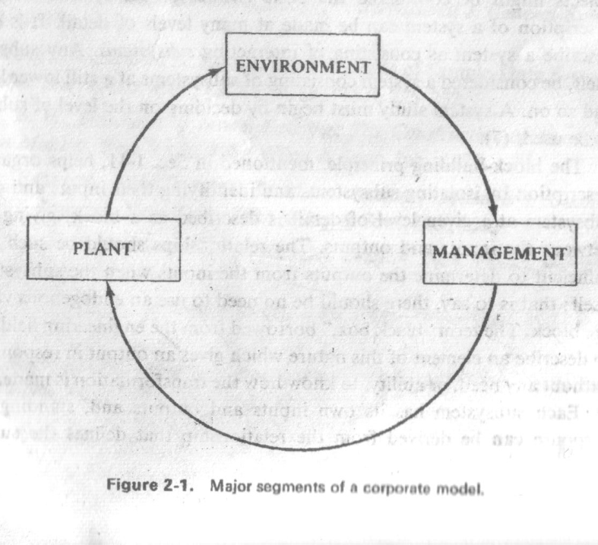
The Corporate Model
Models of this nature called: Corporate Model
Different corporation use this model in various aspects for planning their operations

Slide 23
The Corporate Model
Assume the corporate is a manufacturing industry and
Its planning to produce and market some new product
A first level of details might consider the complete model as consisting of three parts … each of a different general nature.
The corporation operates within an environment
A physical plant …. Means of production
The management segment… policy making aspects

Slide 24
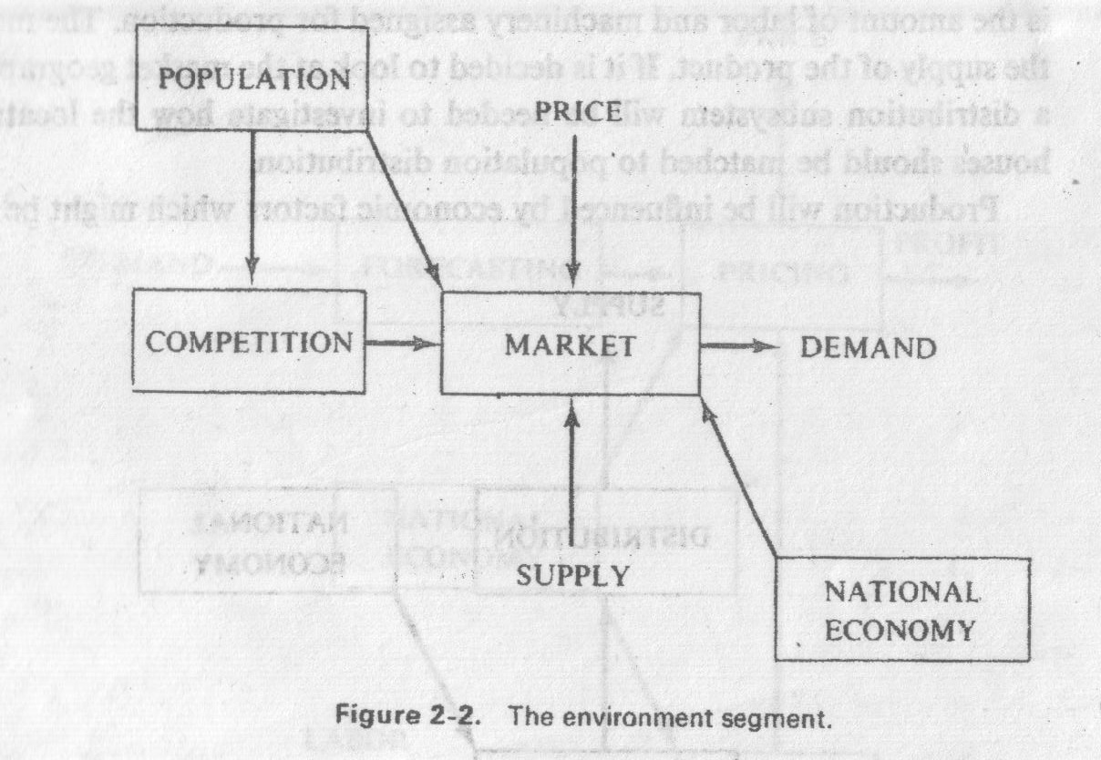
The Environment Segment
The major element: MARKET
Output: Demand
Input: Price & Supply

Slide 25
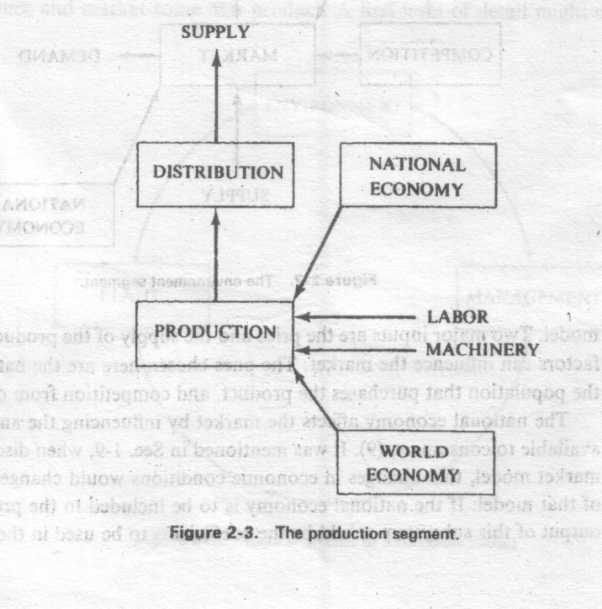
The Production Segment
Main Input: LABOR & MACHINERY
Main Output: SUPPLY

Slide 26
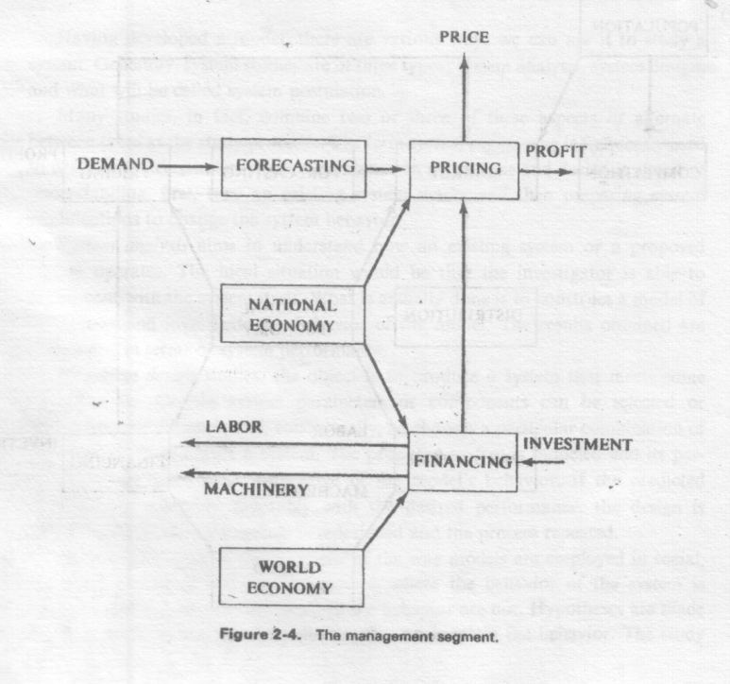
The management Segment
Main Input: DEMAND & INVESTMENT
Main Output: Price to be set & profit to be achieved

Slide 27
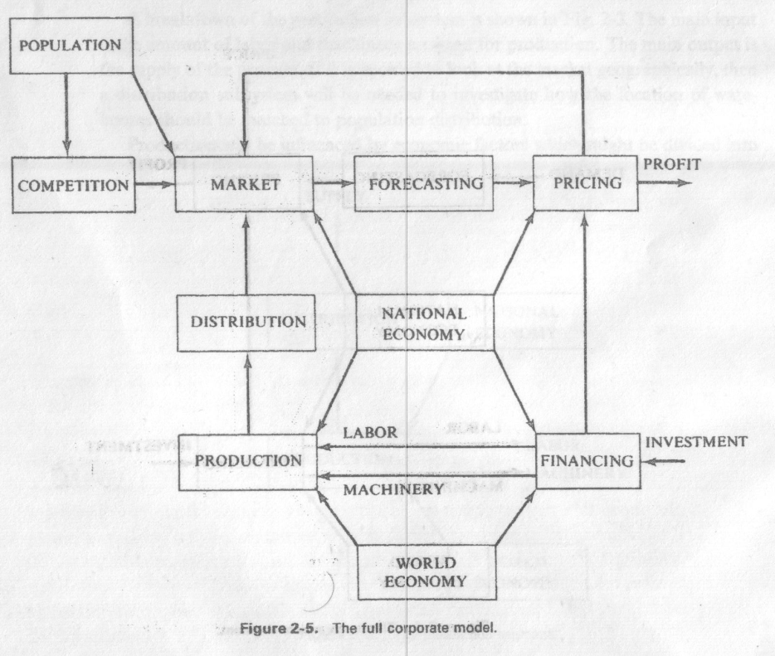
Full Corporate Model
Price
Demand
Supply

Slide 28
Types of System Study
Use of the corporate model?
Having developed a model….
It could be used to study a system.
System study → 3 ways
System analysis
System Design
System Postulation(শর্তারোপন)

Slide 29
System Analysis
System analysis Aims to
Understand how an existing system or a proposed system operates.
In ideal situation …. Investigator … … … able to do some experiment with the system
A comparision is made between existing system and proposed system.
What actually done … to construct a model of the system and investigate the model.

Slide 30
System Design
The objective
Aim is to produce a new system that meets some specification which are designed by the designers.
Certain system parameters or components are chosen by designer
And conceptually he chooses a combination ….. to construct the system.

Slide 31
System Postulation
Postulation(শর্তারোপন) → hypothesis
…is the characteristic of the way models are employed in social, economic, political and medical studies.
Where the behavior of the system Unknown
But the Process that produce the behavior is known.

